Slide 1
Chapter 3
Determinants and Diagonalization

Slide 2
OUR GOAL
How to find the determinant of a square matrix?
How to diagonalize a square matrix?

Slide 3
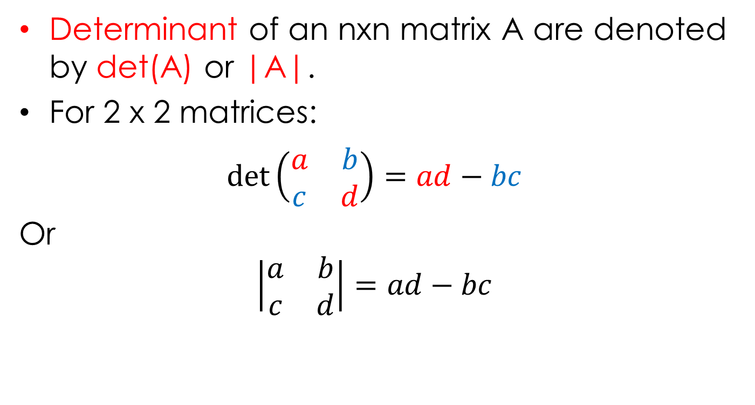
Determinant of a square matrix
Determinant of an nxn matrix A are denoted by det(A) or |A|.
For 2 x 2 matrices:
$det\left(\begin{matrix}a & b \\ c & d\end{matrix}\right)=ad−bc$
Or
$$\left|\begin{matrix}a & b \\ c & d\end{matrix}\right|=ad−bc$$

Slide 4
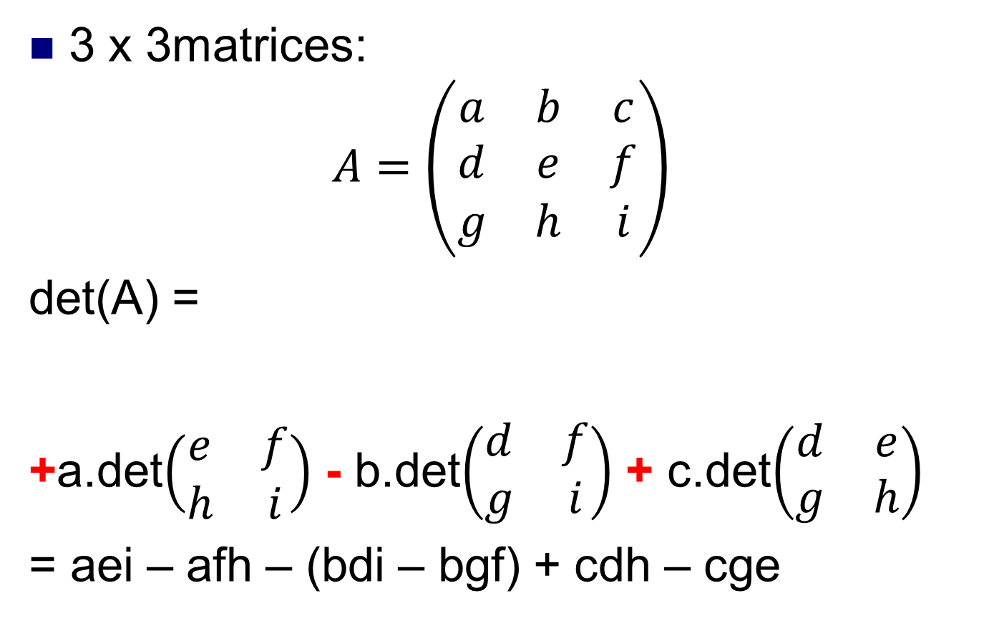
3 x 3matrices:
$$A=\left(\begin{matrix}a & b & c \\ d & e & f \\ g & h & i\end{matrix}\right)$$
det(A) =
+a.det$\left(\begin{matrix}e & f \\ h & i\end{matrix}\right)$ - b.det$\left(\begin{matrix}d & f \\ g & i\end{matrix}\right)$ + c.det$\left(\begin{matrix}d & e \\ g & h\end{matrix}\right)$
= aei – afh – (bdi – bgf) + cdh – cge
+
-
+

Slide 5
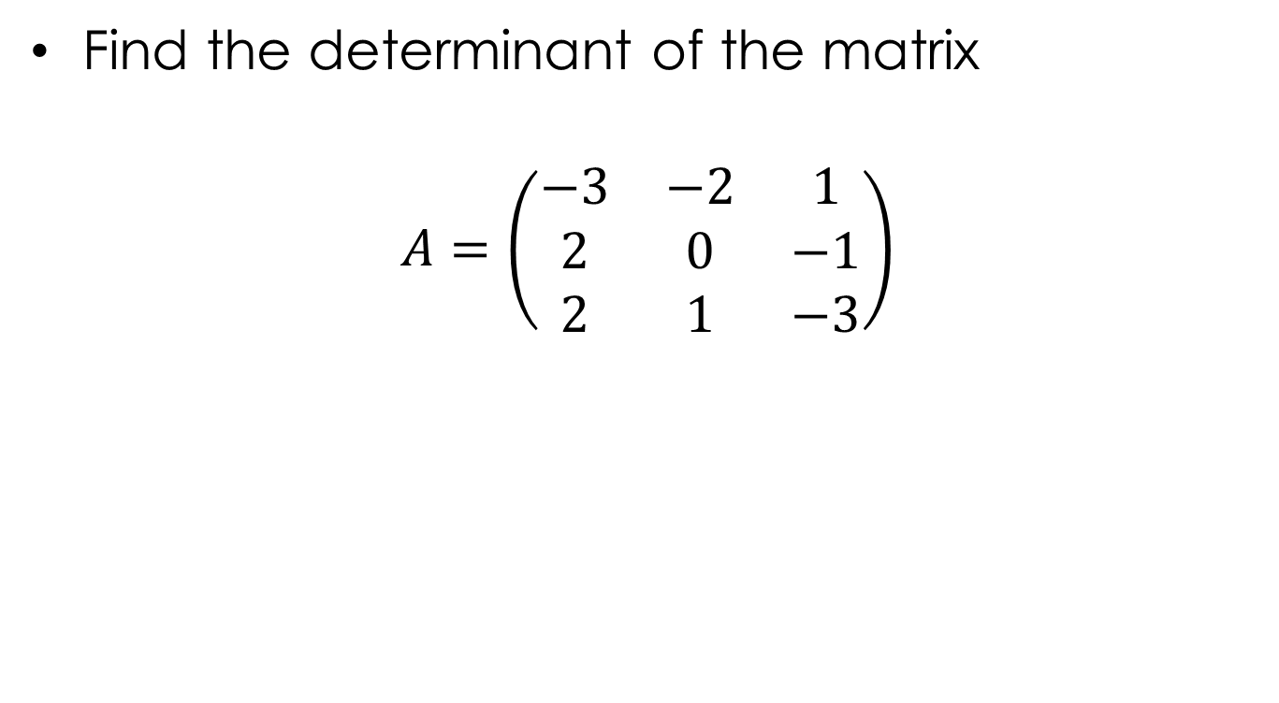
Example
Find the determinant of the matrix
$$A=\left(\begin{matrix}−3 & −2 & 1 \\ 2 & 0 & −1 \\ 2 & 1 & −3\end{matrix}\right)$$

Slide 6
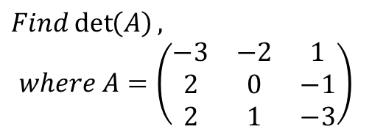
The determinant of 3x3 matrix (only)
$$Find\det\left(A\right),$$
$$where A=\left(\begin{matrix}−3 & −2 & 1 \\ 2 & 0 & −1 \\ 2 & 1 & −3\end{matrix}\right)$$
-3
2
2
-2
0
1
-
-
-
+
+
+

Slide 7
Definition
If A is an mxm matrix then the determinant of A is defined by
detA=a_{i1}c_{i1}(A)+a_{i2}c_{i2}(A)+…+a_{im}c_{im}(A)
or detA= a_{1j}c_{1j}(A)+a_{2j}c_{2j}(A)+…+a_{mj}c_{mj}(A)

Slide 8
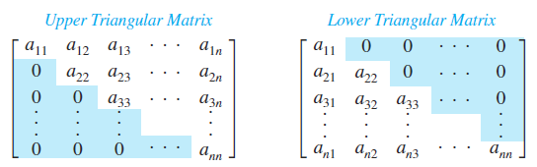
The determinant of triangular matrices
Determinant = a₁₁.a₂₂…a_{nn}

Slide 9
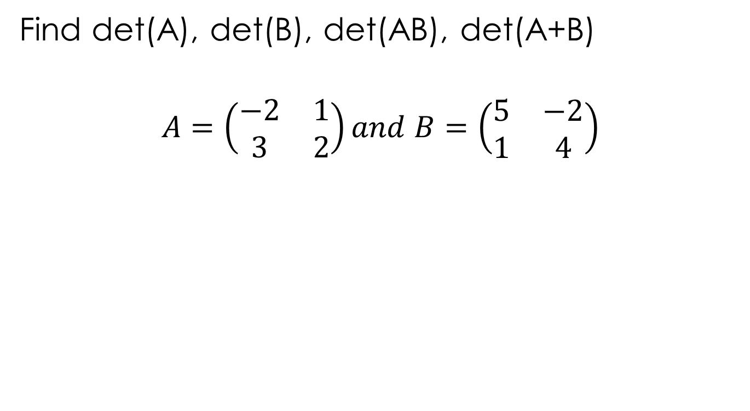
Examples
Find det(A), det(B), det(AB), det(A+B)
$$A=\left(\begin{matrix}−2 & 1 \\ 3 & 2\end{matrix}\right)and B=\left(\begin{matrix}5 & −2 \\ 1 & 4\end{matrix}\right)$$
det(A.B) = det(A).det(B)
det(A+B) ≠ det(A) + det(B)

Slide 10
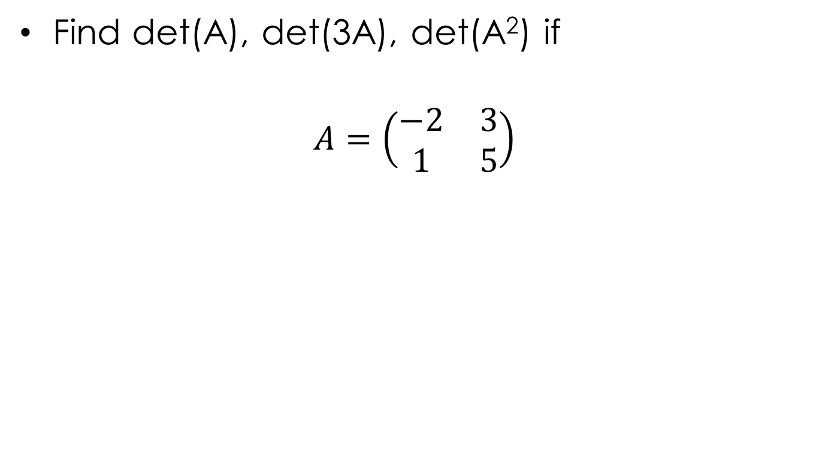
Examples
Find det(A), det(3A), det(A²) if
$$A=\left(\begin{matrix}−2 & 3 \\ 1 & 5\end{matrix}\right)$$
det(cA) = c^{n}det(A)
det(A^{k}) = [det(A)]^{k}

Slide 11
Properties
For all nxn matrices A, B:
det(A.B) = det(A).det(B)
det(kA) = k^{n}det(A)
det(A^{T}) = det(A)
det(A⁻¹) = 1/det(A)
det(A^{k}) = [det(A)]^{k}

Slide 12
The determinant of triangular matrices
Determinant = a₁₁.a₂₂…a_{nn}

Slide 13
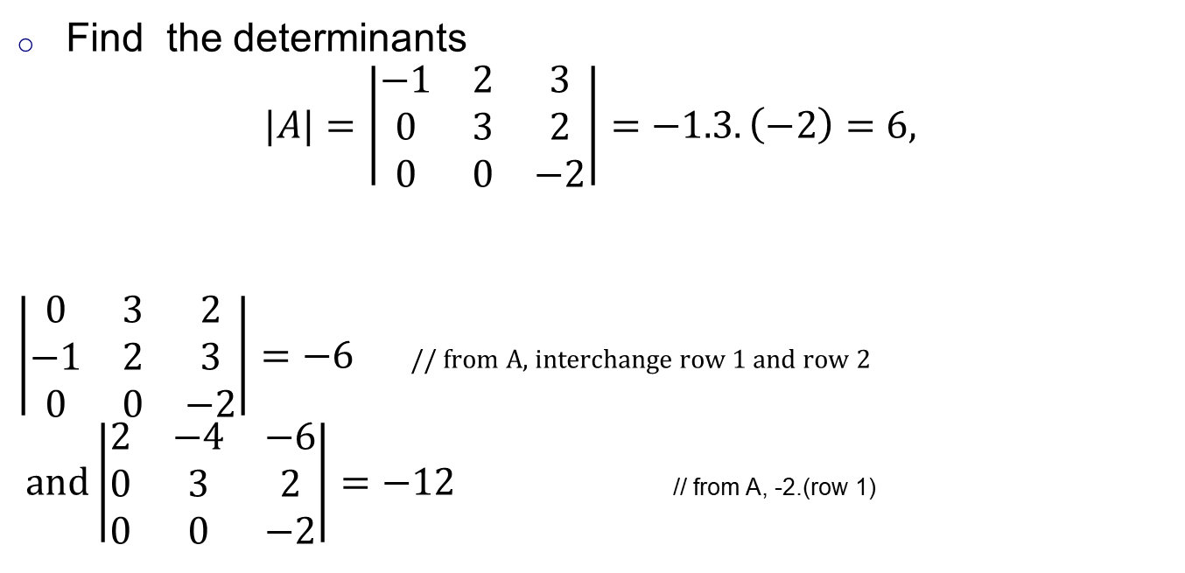
Examples
Find the determinants
$$|A|=\left|\begin{matrix}−1 & 2 & 3 \\ 0 & 3 & 2 \\ 0 & 0 & −2\end{matrix}\right|=−1.3.\left(−2\right)=6,$$
$\left|\begin{matrix}0 & 3 & 2 \\ −1 & 2 & 3 \\ 0 & 0 & −2\end{matrix}\right|=−6$ // from A, interchange row 1 and row 2
$and\left|\begin{matrix}2 & −4 & −6 \\ 0 & 3 & 2 \\ 0 & 0 & −2\end{matrix}\right|=−12$ // from A, -2.(row 1)

Slide 14
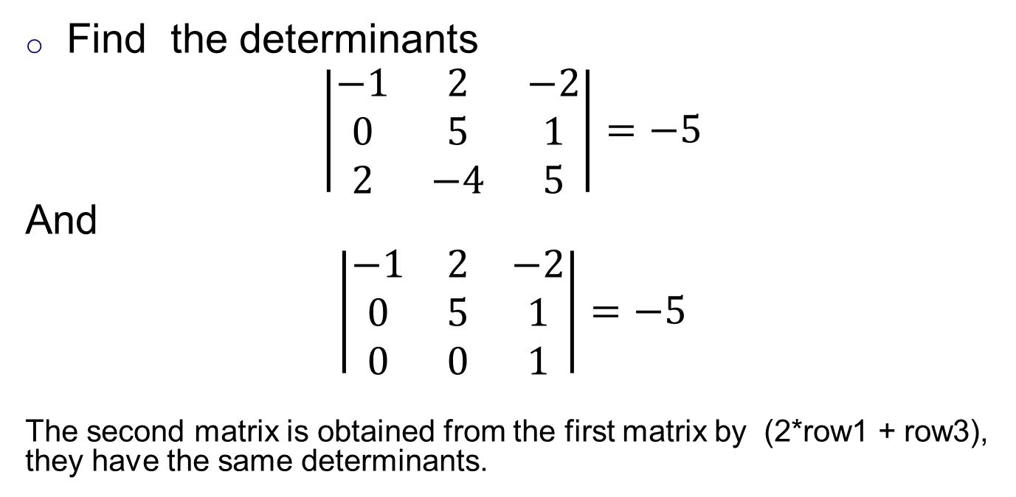
Examples
Find the determinants
$$\left|\begin{matrix}−1 & 2 & −2 \\ 0 & 5 & 1 \\ 2 & −4 & 5\end{matrix}\right|=−5$$
And
$$\left|\begin{matrix}−1 & 2 & −2 \\ 0 & 5 & 1 \\ 0 & 0 & 1\end{matrix}\right|=−5$$
The second matrix is obtained from the first matrix by (2*row1 + row3), they have the same determinants.

Slide 15
Determinants and elementary operators
Đổi chỗ 2 dòng (hoặc 2 cột) cho nhau, matrix thu được và matrix ban đầu có định thức trái dấu nhau. // r_{i} ↔ r_{j}
Nhân một dòng (hoặc cột) với một số k ➔ matrix thu được có định thức gấp k lần det của matrix cũ. //kr_{i}
Nếu nhân c vào dòng r_{i} rồi cộng vào dòng r_{j} (hoặc thực hiện trên cột) ➔ định thức không thay đổi. // cr_{i} + r_{j}

Slide 16
Examples

Slide 17
Next
det(A) and existence of A⁻¹
A is invertible ⇔ det(A) ≠ 0
A formula for finding A⁻¹

Slide 18
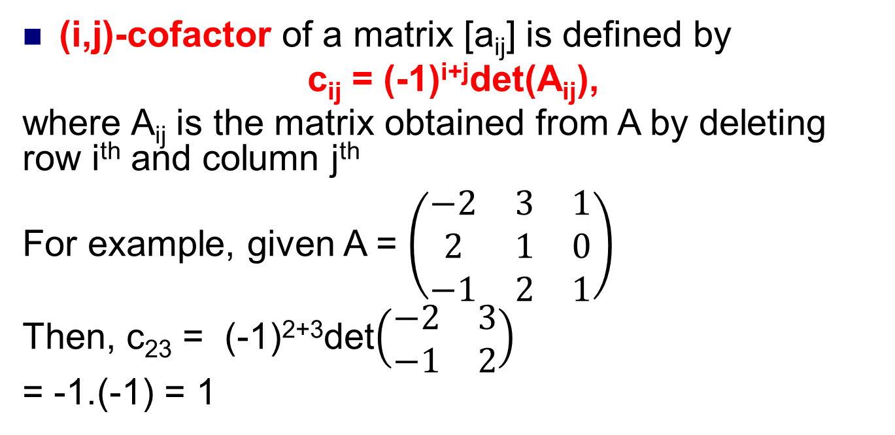
(i,j)-cofactor
(i,j)-cofactor of a matrix [a_{ij}] is defined by
c_{ij} = (-1)^{i+j}det(A_{ij}),
where A_{ij} is the matrix obtained from A by deleting row i^{th} and column j^{th}
For example, given A = $\left(\begin{matrix}−2 & 3 & 1 \\ 2 & 1 & 0 \\ −1 & 2 & 1\end{matrix}\right)$
Then, c₂₃ = (-1)²⁺³det$\left(\begin{matrix}−2 & 3 \\ −1 & 2\end{matrix}\right)$
= -1.(-1) = 1
row 2
column 3
Do yourself. Find all cofactors c_{ij} of the matrix A

Slide 19
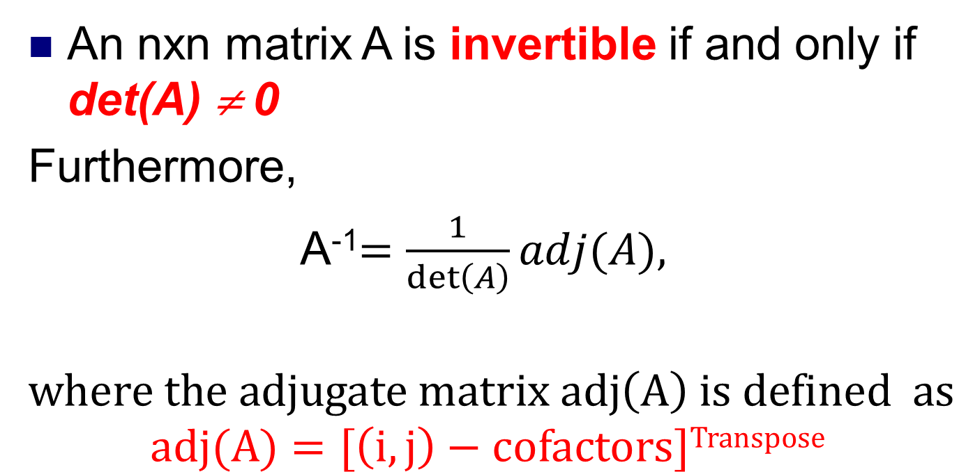
How to find A⁻¹?
An nxn matrix A is invertible if and only if det(A) ≠ 0
Furthermore,
A⁻¹$=\frac{1}{\det\left(A\right)}adj(A),$
$$where the adjugate matrix adj\left(A\right) is defined as$$
$$adj(A)=[\left(i,j\right)−cofactors]Transpose$$

Slide 20
Adjugate matrix
The adjugate matrix of A is the matrix
For example,

Slide 21
Theorem of Adjugate Formula
If A is any square matrix, then
A(adjA)=(detA)I
In particular, if detA≠0 then A is invertible and
For example,
Note that […]

Slide 22
Diagonal matrices
An nxn matrix is called diagonal matrix if all its entries off the main diagonal are zeros
For example

Slide 23
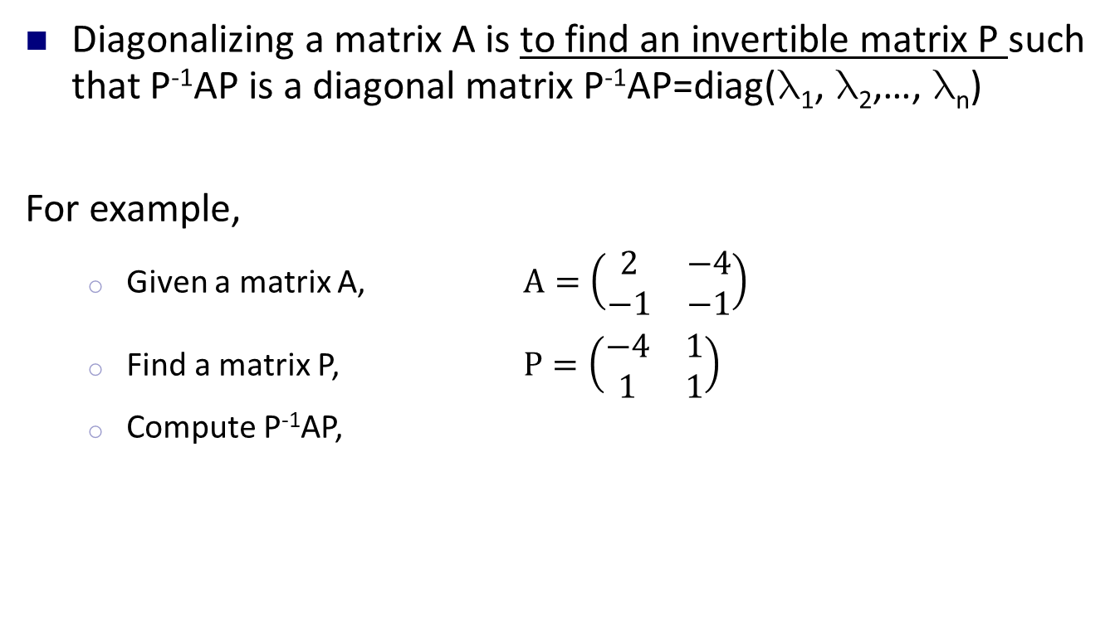
Diagonalization
Diagonalizing a matrix A is to find an invertible matrix P such that P⁻¹AP is a diagonal matrix P⁻¹AP=diag(₁, ₂,…, _{n})
For example,
Given a matrix A, $A=\left(\begin{matrix}2 & −4 \\ −1 & −1\end{matrix}\right)$
Find a matrix P, $P=\left(\begin{matrix}−4 & 1 \\ 1 & 1\end{matrix}\right)$
Compute P⁻¹AP,

Slide 24
How to find P?
Đa thức đặc trưng
(characteristic polynomial)
Các giá trị riêng (eigenvalues) của A
Nếu t≠0 thì X=(-4t,t) được gọi
là véc tơ riêng (eigenvectors)
ứng với giá trị riêng x=3
Nếu t≠0 thì X=(t,t)
được gọi là véc tơ
riêng ứng với x=-2
Relationship between eigenvalues and eigenvectors
: eigenvalue (a number)
X: -eigenvector (remember: vector X≠0)
(I-A)X=0  AX=X

Slide 25
Example
Find the eigenvalues ang eigenvectors and then diagonalize the matrix
The characteristic polynomial of A is

Slide 26
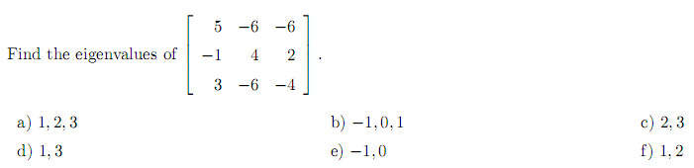
Use the fact: if x1, x2,…, xm are eigenvalues of an nxn matrix , then det(A) = x1.x2…xm
First, det(A) = 4
We know that det(A) = the product of eigenvalues 4 = 1.2.2 ➔ f // x1=1, x2 = x3 = 2.

Slide 27
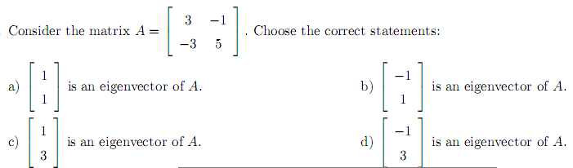
Use the fact: if X is an eigenvector of a matrix A
corresponding an eigenvalue k, then
AX = kX

Slide 28
When is A diagonalizable?
Theorem
A is diagonalizable iff every eigenvalue  of multiplicity m yields exactly m basic eigenvectors, that is, iff the general solution of the system (I-A)X=0 has exactly m parameters.
For example,

Slide 29
When is A diagonalizable?

Slide 30
When is A diagonalizable?

Slide 31
SUMMARY
Determinants of nxn matrices
Properties:
det(AB) = det(A)det(B)
det(cA) = c^{n}det(A)
det(A^{T}) = det(A)
det(A⁻¹) = 1/det(A)
Determinants and elementary operators
Determinants and inverse of a matrix
An nxn matrix has an inverse if and only if det(A) ≠ 0
A⁻¹ = adj(A)/detA
Diagonalization
Characteristic polynomial
Eigenvalues
Eigenvectors

Slide 32
Exercise 3.1.1 Compute the determinants of the following matrices.

Slide 34
Exercise 3.1.10 Compute the determinant of each matrix
Exercise 3.1.8 Show that:

Slide 38
Exercise 3.3.1 In each case find the characteristic polynomial, eigenvalues, eigenvectors, and (if possible) an invertible matrix P such that P−1AP is diagonal.

Slide 40
THANKS

